Slide 1

Time Series Analysis of Air Traffic Data
Forecasting Domestic, International, and Total Air Traffic
Presentation By: Shreeya Sampat

Slide 2


Project Overview
Analysis Steps
Objective
Data Source
To analyze and forecast domestic, international, and total air traffic trends over time
Monthly air traffic data from 2003 to the present, capturing total, domestic, and international flights
Included data preparation, stationarity testing, ACF/PACF analysis, ARIMA model fitting, and residual checks
Forecasting Goal
Key Tools Used
Generate 6-month forecasts to help inform resource planning in air traffic management.
R programming, time series modeling techniques, ACF/PACF analysis, and ARIMA modeling.

Slide 3




Data Preparation and Time Series Creation
Organizing Data for Effective Time Series Analysis
Data Selection: Chose relevant columns — Year, Month, Total Flights, Domestic Flights, and International Flights — to create separate time series for each category.
Data Transformation: Calculated total air traffic and separated domestic and international flights, preparing each series for time series modeling.
Time Series Object Creation: Converted data into monthly time series with a start date of January 2003, using ts() function in R.

Slide 4
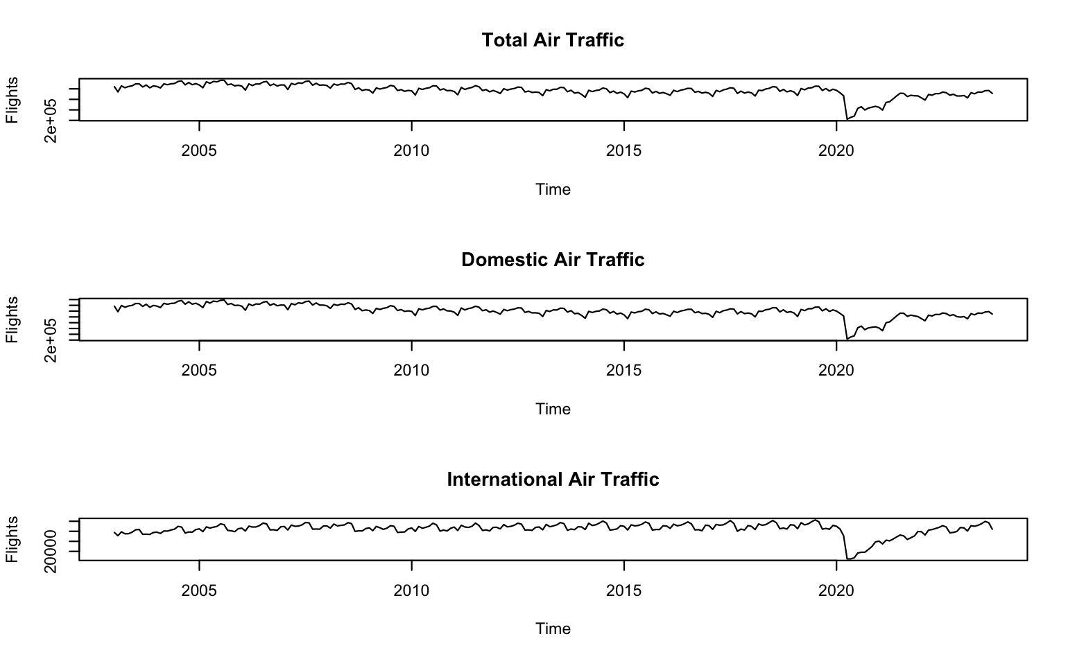
Trends in Air Traffic Over Time
Initial Time Series Plots
Total Air Traffic Trend: Shows a steady upward trend with clear seasonal fluctuations, indicating growth in overall air traffic over time.
Domestic vs. International Patterns: Domestic traffic has a more consistent upward trend, while international traffic shows more pronounced seasonal variations.
Seasonality: All series exhibit seasonal patterns, especially in international flights, which are influenced by peak travel periods.

Slide 5


Stationarity Check: Augmented Dickey-Fuller Test (ADF)
Stationarity Check
Importance of Stationarity: Stationarity is essential for accurate time series modeling, as it ensures the data's statistical properties remain constant over time.
ADF Test Results: Initial Augmented Dickey-Fuller (ADF) tests indicated that none of the series were stationary, as expected due to trends and seasonality.
Differencing for Stationarity: Applied first-order differencing to each series, achieving stationarity and preparing the data for reliable ARIMA modeling.

Slide 6



ACF and PACF Analysis
Identifying Model Components for Time Series
Pattern Observations:
The ACF and PACF plots of the differenced series suggested a mix of AR and MA components, indicating AR(1), MA(1), or ARMA(1,1) models as likely candidates.
Purpose of ACF and PACF: Used ACF (Autocorrelation Function) and PACF (Partial Autocorrelation Function) plots to identify potential AR (Auto-Regressive) and MA (Moving Average) components for each series.
Model Selection Guidance:
Findings from the ACF and PACF plots provided a foundation for selecting and testing models that could best capture the structure of each series.

Slide 7

ARIMA Model Fitting for Each Series
Models Tested: Evaluated AR(1), MA(1), and ARMA(1,1) models for each series (Total, Domestic, and International) based on ACF and PACF analysis results.
AIC Comparison: Selected models with the lowest AIC (Akaike Information Criterion) values, which indicated the best balance between model fit and complexity.
Best Fit Models: For each series, the ARMA(1,1) model was identified as the best fit, capturing both the autoregressive and moving average characteristics observed in the data.

Slide 8
Residual Analysis: Model Adequacy Check
Purpose of Residual Analysis:
Ljung-Box Test:
Model Validation:
Conducted the Ljung-Box test on residuals to statistically verify that the residuals were consistent with white noise, indicating a good model fit.
The results of the residual analysis validated the model selection, confirming that the ARMA(1,1) models were well-suited for each series.
Residual analysis ensures that the chosen models adequately capture the patterns in the data, leaving only random noise in the residuals.
ACF of Residuals:
Results Summary:
Examined the ACF plots of residuals for each model (Total, Domestic, International) to confirm that there were no significant autocorrelations remaining.
All selected models showed residuals that resembled white noise, as evidenced by non-significant ACF lags and high p-values in the Ljung-Box test.

Slide 9




Forecasts for Next 6 Months
Forecasting Objective: Generated 6-month ahead forecasts for Total, Domestic, and International air traffic to anticipate future trends and support planning.
Method Used: Used the best-fitting ARMA(1,1) models for each series to produce forecasts with 95% confidence intervals.
Forecast Insights: Total and Domestic air traffic forecasts show a continued upward trend, while International traffic displays seasonal fluctuations.
Practical Implications: These forecasts can inform resource allocation, scheduling, and capacity planning in the air traffic and transportation sectors.

Slide 10
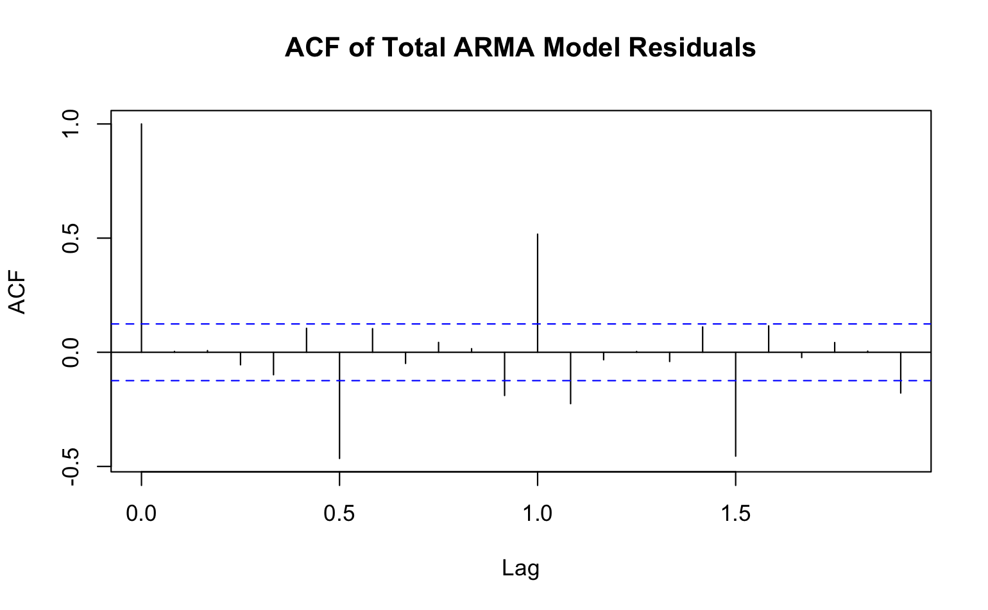
Summary of Key Findings
Summary of Findings
Growth in Air Traffic: Observed a steady increase in Total and Domestic air traffic over time, with International traffic showing seasonal peaks.
Effective Model Selection: The ARMA(1,1) models were effective in capturing the patterns in each series, validated by residual analysis and AIC comparisons.
Forecasting Application: Forecasts predict a continued rise in air traffic, highlighting the need for proactive planning in infrastructure and resource management.

Slide 11

Recommendations and Future Analysis
Incorporate External Factors: Future analysis could include economic indicators, seasonal events, or global travel trends to enhance the accuracy and robustness of the forecasts, providing deeper insights for strategic planning in air traffic management.

Slide 12

Thank you
Thank You for you time!

